Slide 1
RTOS Concepts & Definitions
An Overview With Practicals Using ARM Architecture

Slide 2
PREREQUISITE
KNOWLEDGE ABOUT SOFT WARE INTERRUPTS IN ARM ARCHITECURE
AND ITS USE IN FOR DESIGN & USE OF SYSTEM CALL OF RTOS.
KNOWLEDGE/EXPOSURE TO GENERAL PURPOSE OS CONCEPTS.

Slide 3
AGENDA
What is an OS ?
Why OS is Primarily Required ?
What is General Purpose OS (GPOS) ?
What is Embedded System ?
What is Embedded OSes ?
What is Real Time Operating System ( RTOS) ?
Non RTS vs RTS
Soft RTS vs Hard RTS

Slide 4
What makes an OS an RTOS ?
What is a Re-entrant Function
What is meant by Porting of RTOS ?
What is BSP(Board Support Package) ?

Slide 5
Discussion
What is an OS ?
An Operating System(OS) is a control program used for managing the resources of an computing system and provide a platform in the form of a Command Line(CLI)/Graphical User Interface (GUI) for conveniently using the system without bothering about the underlying details of hardware operations.

Slide 6
OR
An OS is simply an interface between the USER & the Computing Hardware.
E.g: Windows,UNIX,Linux,MAC – General Purpose Operating System.

Slide 7
Why OS is Required Primarily ?
To Ensure that CPU is never idle, & increase percentage of effective utilization.
A Single Process/Application which is single tasking/threaded may sometimes be unable to keep the CPU really engaged optimally,even though capable design wise BUT constrained by Application (Software).
Hence Solution is Multi-Tasking/Multi-Threading via an OS.

Slide 8
What is GPOS ?
A GPOS is an OS which has a lot of PARAPHERNALIA(modules/packages/support) to support the requirements of varieties of End-Users from various walk of Life (from small Kids to Aged People) who would like to use Desktops,Laptops,Tablets,Smart Phones.

Slide 9
OS as a Service Provider
Task/Thread/Process Scheduling based on some Scheduling Policies
Memory Management
File Management
I/O Devices Management
Inter Task/Thread/Process Communication for exchange of information
Synchronization between tasks when dealing with shared resources.

Slide 10
OS Components
Life Cycle of Task/Thread/Process (States)
Scheduler
Dispatcher
Event Management
Inter Task Com & Synchronization

Slide 11
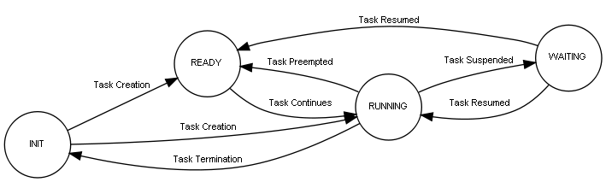

Slide 12
What is a Scheduler ?
The scheduler is the part of the kernel responsible for deciding which task should be executing at any particular time.
The scheduling policy is the algorithm used by the scheduler to decide which task to execute at any point in time.
E.g RRS,PBS, RMS ,CS,SJF,MLFBQ,

Slide 13
What is a dispatcher
The dispatcher is comes after the scheduler.
It gives control of the CPU to the process selected by the scheduler.

Slide 14
AGENDA
What is Super Loop Architecture ?
What is an Embedded Operating System (Embedded OS) ?
What is Real Time Operating System ( RTOS) ?
What is Real Time System (RTS) ?
Non RTS vs RTS
Soft SRTS vs Hard RTS

Slide 15
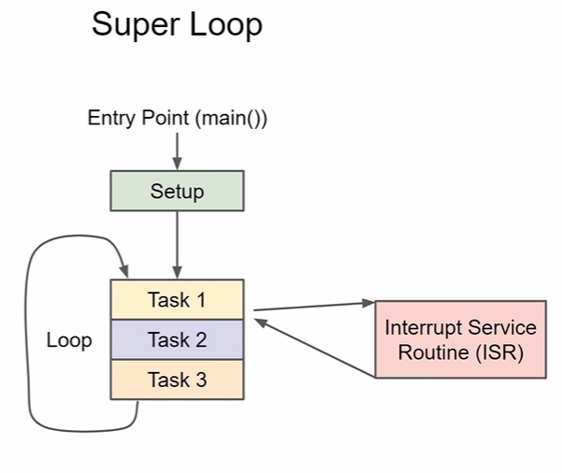
What is Super Loop Architecture ?

Slide 16
What is Embedded OS ?
Embedded OS is an OS customized for size & services required for a specific embedded system which requires multi-tasking capability.

Slide 17
What is a Real Time Operating System (RTOS) ?
A Real Time Operating System is an Embedded Operating System but further customized for size & services required & a well optimized for time contraints/deadlines in output deliveries for the specific embedded system.

Slide 18
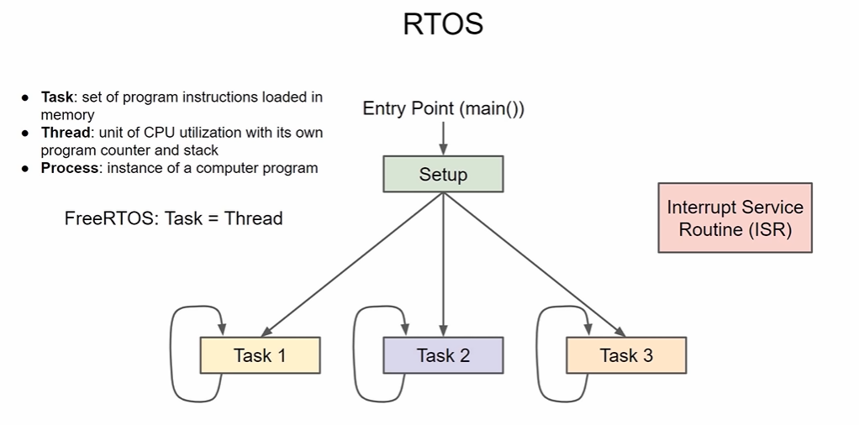

Slide 19

What is Real-Time system?
A system in which the correctness of the computation not only depends upon the logical correctness of the computation but also upon the time at which the result is produced.
Computation is performed during the actual time that an external process occurs, in order that the computation results may be used to control, monitor, or respond in a timely manner to the external process
A real-time system responds in a (timely) predictable way to unpredictable external stimuli arrivals

Slide 20
What is Hard RealTime
A system where all the critical tasks are highly deterministic.
Late response is considered to be a wrong response. Hence all the real time tasks not only produce logically correct result, but also their delivery time is predictable.
OS used in Mission-critical systems, like automotive, avionics, space missions, medical equipment are supposed to be hard real time.

Slide 21
What is Soft-realtime
A system where miss in task deadline is not a Catastrophe(disaster / Hazard), but possible a reduction in quality.
Home appliance, real video streaming, set-top box (in DTH ) in television,mobile phones,etc.

Slide 22
What makes an OS an RTOS ?
What is a Re-entrant Function
What is meant by Porting of RTOS ?
What is BSP(Board Support Package) ?

Slide 23
What makes OS a RTOS?
RTOS has to ROMable preferably.
RTOS has to be scalable preferably.
RTOS Has to be configurable.
RTOS Has to be deterministic.
RTOS Has to support predictability.
RTOS has to support multi-threaded and preemptive.
Scheduling of multiple threads must be preferably priority based, can use round-robin, or cooperative scheduling also.
Should provide predictable thread synchronization.

Slide 24
Priority Inheritance must exist through dynamic priority management.
Interrupt Latency , Interrupt Response and Interrupt Recovery must be calculable.
Every system call’s maximum time of completion should provided/known for a given target’s specification.
System interrupt levels must be known to the developer of the system.

Slide 25
What is Reentrant function?
A function/Sub-routine when invoked simultaneously or nested or interleaved should not interfere with each other.
Shares same copy of code but different copies of data for protection.
Usually use local variables. Global and static variables are discouraged.
Particularly useful in implementation of recursive functions and Interrupt handling.

Slide 26
What is Porting of RTOs ?
RTOS contains two parts:
one is processor specific codes & another one is processor independent codes.
Porting means write the above two parts in to ur device which is going to be ported & change the processor specific codes inorder to support the independent part of RTOS code.

Slide 27
Porting is divided into two types:
1. Architecture Porting which ports the context switch and interrupts to the OS
2. Board porting which is concerned to board support package and device drivers

Slide 28
What is BSP?
A Platform dependent package (in form of source code or binary files) provided by RTOS developers to build the RT-Kernel on a Customized hardware platform .
Sometimes it is a collection of drivers and HALs (Hardware Abstraction Layer).
It also largely depends on OEM’s (Original Equipment Manufacturer) hardware specification.

Slide 29
What is TCB?
A Task’s context need to be saved when context switch occurs in a multi-tasking environment.
The data structure for saving is called as Task/Thread Control Block or TCB.
TCB mainly contains the following
  Thread ID of execution, that is, the task's program counter
  the CPU registers and (optionally) floating-point registers
  a stack for dynamic variables and function calls
  I/O assignments for standard input, output, and error
  a delay timer
  a time-slice timer
  etc

Slide 30
What is Critical Section?
A section of code in a program , while executing , no other program should execute.
All interrupts must be disabled while Critical Section code is executing including the Scheduler interrupt.

Slide 31
What is a Deadlock/Deadly Embrace?
A deadlock is a situation wherein two or more task are waiting fo resources held by the each other. .

Slide 32
Necessary Conditions for Deadlock
Mutual exclusion: resources cannot be shared.
Hold and wait: processes request resources incrementally, and hold on to what they've got.
No preemption: resources cannot be forcibly taken from processes.
Circular wait: circular chain of waiting, in which each process is waiting for a resource held by the next process in the chain.

Slide 33
Strategies for dealing with Deadlock
ignore the problem altogether.
detection and recovery
avoidance by careful resource allocation
prevention by structurally negating one of the four necessary conditions.

Slide 34
Deadlock Avoidance
Acquire all resources before proceeding
Acquire resource in an order and release in reverse order
Change priorities dynamically if required & possible
enable watch dog timer as an anticipation for dead lock.

Slide 35
Interrupts
Hardware mechanism to inform the CPU that an asynchronous event has occurred
The ISR processes the event and returns to
  the background in a foreground/ background system
  the interrupted task for a non preemptive kernel
  the highest priority task ready to run for a preemptive kernel
Notes:
We will have a closer look at the interrupts which are the key to real time programming. The processors can process the events as they occur if they are working through interrupts.This avoids the processor wasting its time in polling an event.

Slide 36
Interrupt Timings
TIME
Context
saved
Context
restored
TASK
Background
Interrupt
Latency
User ISR code
Interrupt
Request
ISR
Interrupt
Recovery
Interrupt Response
Notes:
The figure explains the various interrupt latency,interrupt recovery and interrupt response timings for a foreground / background method and a non preemptive kernel.

Slide 37
TIME
Context
saved
ISR entry
function
ISR exit
function
Context
restored
TASK A
Task A
Interrupt
Latency
User ISR code
Interrupt
Request
ISR
Interrupt
Recovery
Interrupt Response
Task B
Interrupt
Recovery
Notes:
The figure explains the various interrupt latency,interrupt recovery and interrupt response timings for a preemptive kernel.Here,after the ISR is served,the kernel can return back to the interrupted task or to a higher priority task that was made ready by the ISR.The interrupt recovery time in the latter case is going to be more as the context switch is going to take more time.

Slide 38
Interrupt Latency
Interrupt latency is the sum of the maximum amount of time interrupts are disabled and the time to start executing the first instruction in the ISR
The longer the interrupts are disabled, the higher the interrupt latency
Notes:
Interrupt latency is processor specific. But the real time kernel suppliers will have to provide the details about these timings along with the other specifications.

Slide 39
Interrupt Response
Time between the reception of the interrupt and the start of the user code that handles the interrupt
For a foreground background system and non preemptive kernel = interrupt latency + time to save the CPU’s context
For a preemptive kernel = interrupt latency + the time to save the CPU’s context + execution time of the kernel ISR entry function
Notes:
Also known as the response time. Normally,once the processor is interrupted,it saves its program counters and associated segment registers (context) and enters into the ISR.Preemptive kernel,on the other hand calls a special function which notifies to the kernel that an ISR is in progress and lets the kernel to keep track of interrupt nesting.In MicroC/OS-II it is the function OSIntEnter().

Slide 40
Interrupt Recovery
Time required for the processor to return to the interrupted code
For a foreground/background system and non preemptive kernel = time to restore the CPU’s context + time to execute the return from interrupt instruction
For a preemptive kernel = time to determine if a higher priority task is ready + time to restore the CPU’s context of the highest priority task + time to execute the return from interrupt instruction
Notes:
In a preemptive kernel,a function [OSIntExit()] is called.This function allows the kernel to determine whether all interrupts have nested.If they have nested,the kernel determines if a higher priority task has been made ready to run as a result of the ISR.If so,it will run that task.Hence,we see that the interrupted task will only resume when it becomes the highest priority task ready to run.

Slide 41
Priority Inversion Problem
Priority inversion is an undesirable situation in which a higher priority task gets blocked (waits for CPU) for more time than that it is supposed to, by lower priority tasks.
Example:
Let T₁ , T₂ , and T₃ be the three periodic tasks with decreasing order of priorities.
Let T₁ and T₃ share a resource “S”.

Slide 42

Priority Inversion example
A higher priority task waits for a lower priority task
Makes a request for resource S and gets blocked
Resource S is available and T1 is scheduled here
T1
Highest priority
T₁
T₁
T2 completes
Preempted by higher priority task T1
L1
T₂
T3 completes
T2
T3 is the only active task
Medium priority
Preempted by higher priority task T2
K3
K1
K2
T3
T₃
T₃
T₃
Least priority
0
T1 and T3 share resource S
Total blocking time for task T1 = (K1+K2+K3) + (L1)

Slide 43
Priority Inheritance Protocol
priority inheritance protocol—ensures that the priority level of the lower priority task
that has acquired the mutex is raised to that of the higher priority task that has requested the
mutex when inversion happens. The priority of the raised task is lowered to its original value
after the task releases the mutex that the higher priority task requires.

Slide 44
Priority Ceiling Protocol
ceiling priority protocol—ensures that the priority level of the task that acquires the mutex is automatically set to the highest priority of all possible tasks that might request that mutex when it is first acquired until it is released.
Similarly to the ceiling priority protocol, the priority of every task is known in the priority ceiling protocol. The resources that every task requires are also known before execution. The current priority ceiling for a running system at any time is the highest priority ceiling of all resources in use at that time.

Slide 45
Priority Inversion - Real-world Example
Mars Pathfinder mission (July 4, 1997)
VxWorks (real-time OS), preemptive priority scheduling of threads (e.g., RMS)
Priority inversion involving three threads:
  Information bus task (T1), meteorological data gathering task (T3), communication task (T2). Priority order: T1>T2>T3
  Shared resource: information bus (used mutex)
Same situation as described in the previous example had occurred
Findings: Priority ceiling protocol was found to be disabled initially, then it was enabled online and the problem was corrected

Slide 46
What is meant by a jitter ?
Timing error of a task over subsequent iterations of a program or loop is referred to as jitter.
Hard RTOS are optimized to minimize jitter the most.

Slide 47
What is a clock tick ?
A clock tick is a special interrupt that occurs periodically. This interrupt can be viewed as the system's heartbeat.
The time between interrupts is application specific and is generally between 10 and 200 mS.

Slide 48
The clock tick interrupt allows a kernel to delay tasks for an integral number of clock ticks and to provide timeouts when tasks are waiting for events to occur.
The faster the tick rate, the higher the overhead imposed on the system.

Slide 49
Types of RTOs

Slide 50

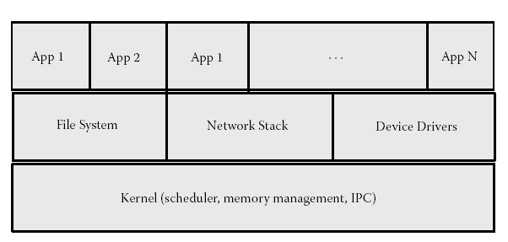

Slide 51
Traditional/RealTime Executive RTOs
Were meant for MMU-less, restricted on chip/off chip memory processors.
Supports flat/linear address space with no memory protection between the kernel and applications,
Have small memory and size footprint as both the OS and applications are bundled into a single image.
All software running on the system should be foolproof.

Slide 52
There is no overhead of system calls, message passing, or copying of data.
Applications or kernel modules cannot be dynamically added to the system.

Slide 53
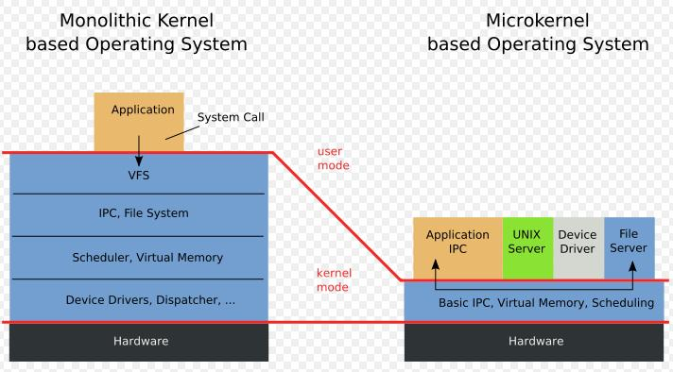

Slide 54
What is a micro kernel ?
Suited for processors having MMU/MMU less.
If CPU supports modes, the micro kernel is the only software executing at most privileged level (supervisor/kernel mode).
The microkernel makes use of a small OS that provides the very basic service (scheduling, interrupt handling, message passing)
And the rest of the kernel subsystem (file system, device drivers, networking stack) runs as applications in user space.

Slide 55
Must support well-defined APIs for communication with the OS as well as robust message-passing schemes.

Slide 56
What is Monolithic Kernel ?
Clear Distinction between the user and kernel space.
User space normally cannot access the system hardware nor can it execute privileged instructions.
Using special entry points (provided by hardware), an application can enter the kernel mode from user space.
User space programs operate on a virtual address hence corruption of another application’s or the kernel’s memory avoided.
Support dynamic loading of separately compiled kernel modules or applications without bringing down the system.

Slide 57
Few more questions
Explain what is scalable and configurable feature in RTOS.
Why the virtual memory may be absent in RT Kernels?
What is advantage if virtual memory is absent ?
What is the advantage of Micro-kernel?
How to reduce latency?
What is priority inheritance?
What is priority inversion ?
What is watchdog timer?
What is clock tick of an RTOs ?
What is a task,resource,context switching… ?

